Slide 1
Mitral cells in olfactory bulb transmit ortho versus retro modality
Paper argues that because drug manipulations lead to worse decoding of ortho versus retro, OB may “favor” encoding the modality.
Synaptic adaptation: slower time course of retro stimulation causes the retro responses to be stronger and less sensitive to drug manipulations than ortho
Their firing rate model “shows” that OB can transmit modality information downstream

Slide 2
They delivered 1s stimulus of Ethyl Butyrate and 1-Hexanone but excluded 1-Hexanone from analysis because it’s a non-food odor
Used GABA drugs on OB via gel foam pieces soaked in ACSF surrounding the electrodes 10 minutes before recording
Compared the populations of neurons mean responses in each condition.
Considered how individual Mitral Cells encode modality

Slide 3
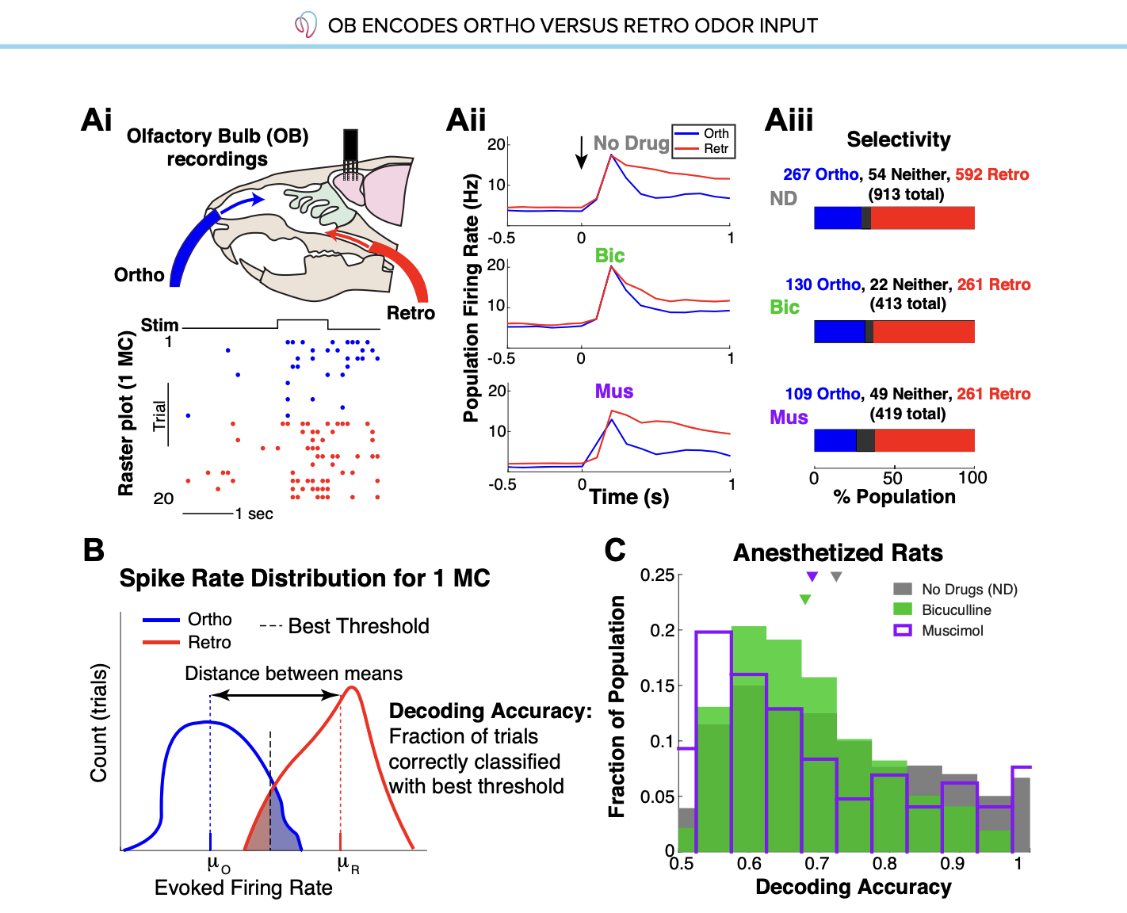
Anesthetized Tracheotomized Rats
Overall higher selectivity for Retro

Slide 4
The mean decoding accuracy of mitral cells without drugs of modality is about 72.4% accurate.
With Bicuculine and Muscimol it drops to 68.0% and 69.0% respectively
What does it mean when there are high correlations between mean firing rates and standard deviations?
Evoked firing rates are only significant across drug preparations with ortho stimuli

Slide 5
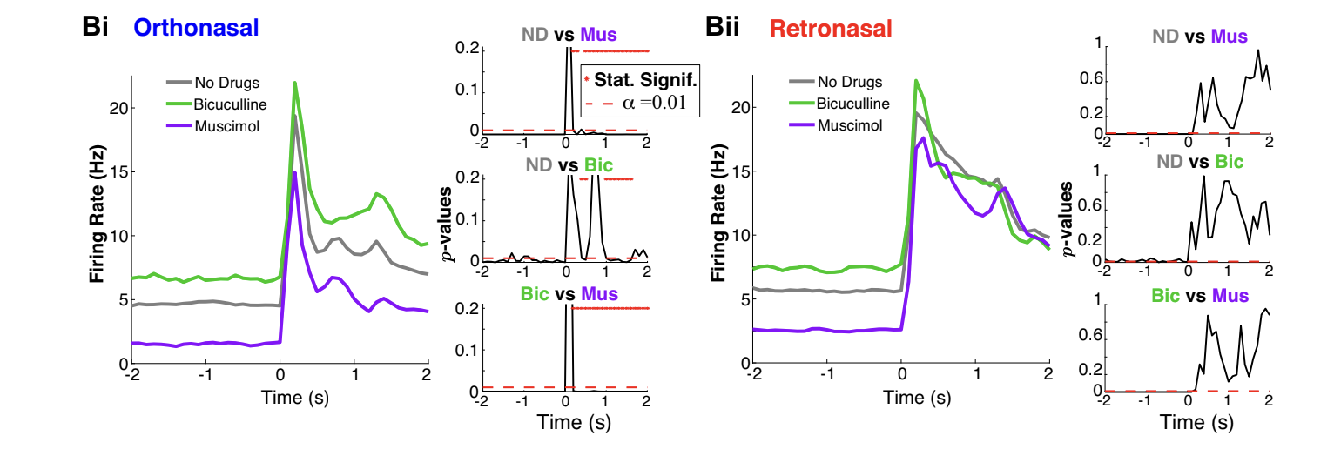
Firing rate differences in population activity

Slide 6
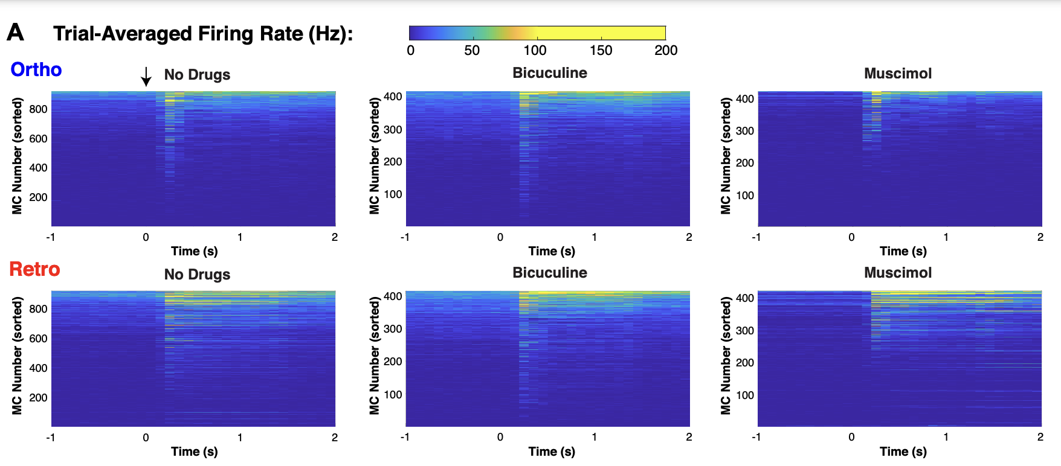

Slide 7
Muscimol causes only significant average trial variance differences in Retro and Ortho
Then they introduce their firing rate model
Limitation they note is that they only used one odor and one concentration

